Slide 1
Cost Accounting Standards - Basics
Background & History and CAS Contract Determination

Slide 2
History of the Cost Accounting Standards
In the 1960's a growing concern was expressed about differing cost accounting practices being followed under defense contracts. House Report 1455 dated May 23, 1968, observed that the absence of Standards for defense contract cost accounting was adversely affecting Government procurements.
According to published statistics, total Government procurement for the fiscal year '1969 amounted to' $53 billion, of which $45.9 billion,, or 86.6 percent, represented negotiated procurements-- procurements not formally advertised. Total Department of Defense procurement for the fiscal year 1969 amounted to $40.8 billion, of which 536.3 billion, or 89.0 percent, was negotiated.
In the course of testimony before the House Banking and Currency Committee on the extension of the Defense Production Act, Admiral Hyman Rickover pressed for uniform cost accounting standards. He argued that more than 2 billion dollars could be saved annually by the government; he alleged contractors were overcharging in absence of uniform cost accounting standards (Mulligan 1970, p. 19).
Notes:
In the 1960's a growing concern was expressed about differing cost accounting practices being followed under defense contracts. One report, in the House or Representatives, House Report 1455 dated May 23, 1968, observed that the absence of standards for defense contract cost accounting was adversely affecting Government procurements.
In fiscal year 1969, total government procurement was 53 Billion, of which $45.9B represented negotiated procurements. These were procurements where cost or pricing data was used, rather than advertised or competitive procurements. Of the $53B of government spending, $40B was related to DoD, which a similar percentage being negotiated procurements.
The numbers for cost or pricing data procurements were large, and there were increasing pressures for Congress to act and establish cost accounting standards to put the government on a level playing field.
Admiral Rickover, who established the nuclear propulsion program for the Navy, testified that more than 2 billion dollars could be saved annually by establishing uniform cost accounting standards. In the absence of uniform cost accounting standards, he alleged contractors were overcharging.
Note: Admiral Rickover, was running one of the largest programs at DoD, and he saw first-hand how this “overcharging” was occurring due to the changing of costs estimating and cost accounting methods and standards.

Slide 3
Admiral H. G. Rickover – Deputy Commander for Nuclear Propulsion, Naval Ship Systems Command – 1968
“The lack of uniform accounting standards is the most serious deficiency in Government procurement today";
The "industry will not establish such standards because it is not to their advantage to do so";
The accounting profession "has had ample time and opportunity to establish effective standards" but pays "only lip service to the concept"; and
"If uniform accounting standards are ever to be established the initiative will have to come from Congress."
"In the absence of true competition, the Government must rely on contractor cost estimates and cost records in pricing its contracts. However, under today's procurement rules, it is virtually impossible to discover what it costs to manufacture defense equipment and what profit industry makes in producing it--unless months are spent reconstructing suppliers ' books. Contracting Officers repeatedly face the Hobson's choice of delaying important work to analyze thoroughly and negotiate costs or placing the contract without understanding fully the basis for the price."
Notes:
More statements from Admiral Rickover. He had a lot at stake in fixing these issues as these issues were not only affecting his program, but DoD as a whole.
“The lack of uniform accounting standards is the most serious deficiency in Government procurement today";
The "industry will not establish such standards because it is not to their advantage to do so"; Doing so takes away their advantage of changing their methods of pricing and accumulating costs, and inevitably hurts their profit
The accounting profession "has had ample time and opportunity to establish effective standards" but pays "only lip service to the concept"; Lip service meaning the industry and accounting profession says that would like to fix these issues, but they will not act, it is not to their benefit to fix., and
"If uniform accounting standards are ever to be established the initiative will have to come from Congress."
"In the absence of true competition, the Government must rely on contractor cost estimates and cost records in pricing its contracts. However, under today's procurement rules, it is virtually impossible to discover what it costs to manufacture defense equipment and what profit industry makes in producing it--unless months are spent reconstructing suppliers ' books. Contracting Officers repeatedly face the Hobson's choice of delaying important work to analyze thoroughly and negotiate costs or placing the contract without understanding fully the basis for the price."

Slide 4
Address by the Comptroller General of the United States, Elmer B. Staats, Dallas Texas, September 11, 1969
A recurring problem in Government contracting is that, in reporting to the Government on both proposed and incurred costs, contractors may select from alternative accounting methods without specific criteria governing such selection. In other words, contractors sometimes present cost data in pricing proposals differently from they record their cost of performance.
This problem adds difficulty concerning compliance with Public Law 87-653, the Truth-In-Negotiations Act (TINA), approved September 10, 1962. The act provides that a contractor must certify that to the best of his knowledge and belief the cost or pricing data he/she submitted was accurate, complete, and current.
Properly administered cost accounting standards, together with disclosure by the contractor of his cost- - accounting practices and agreement thereto by the responsible Government representative, could do much to promote a common understanding as to the methods of cost determination to be used consistently under the specific, circumstances and thereby minimize subsequent controversy in the administration and settlement of the contract.
Notes:
This slide captures the issues associated with cost accounting standards, or lack thereof, as stated by the Comptroller General of the US in 1969.
A recurring problem in Government contracting is that, in reporting to the Government on both proposed and incurred costs, contractors may select from alternative accounting methods without specific criteria governing such selection. In other words, contractors sometimes present cost data in pricing proposals differently from they record their cost of performance.
This problem adds difficulty concerning compliance with Public Law 87-653, the Truth-In-Negotiations Act (TINA), approved September 10, 1962. The act provides that a contractor must certify that to the best of his knowledge and belief the cost or pricing data he/she submitted was accurate, complete, and current. So, I wanted to make sure I captured this. If a contractor elects to change its methodology between the way it bids its contracts and accounts for them, and does not disclose this to the government, then the government is not on equal footing or a level playing field. The contractor has not provided complete information. So, even if you are not a CAS covered organization you can still get in trouble violating TINA. If you are a CAS covered contractor and are non-compliant with a CAS standard, the government may also pursue defective pricing and false claims acts violations. THIS IS IMPORTANT.
Properly administered cost-accounting standards, together with disclosure by the contractor of his cost accounting practices and agreement thereto by the responsible Government representative, could do much to promote a common understanding as to the methods of cost determination to be used consistently under specific circumstances and thereby minimize subsequent controversy in the administration and settlement of the contract.
Between this slide and the previous slide it should become apparent that cost accounting standard issues are big issues, ones in which the government takes it seriously, and ones in which non-compliance can bleed over to other non-compliances such as TINA and the False Claims Act. Even if you are not a CAS covered organization, you still need to apply consistency in your cost accounting in your proposals and actual costs.

Slide 5
CAS Overview
CAS (48 CRF, Part 99) establishes Cost Accounting Standards for determing the cost of “final cost objectives.
Governs the measurement, assignment and allocation of costs
Allocation of Costs
Cost allocation means “to assign an item of cost, or a group of items of cost, to one or more cost objectives
CAS Preference for direct allocation
Fundamental Requirement: cost are allocated on a causal beneficial relationship

Slide 6
CAS Application
Requires “triggering” covered contract - $7.5M
Then applies to all contracts in excess of $2M unless an exemption applies.
Exemptions include:
Competitive firm fixed price
Commercial Items
Small Businesses are exempt

Slide 7
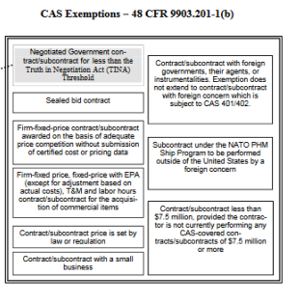
Is your Organization CAS Covered – CAS Determination
FAR Part To be CAS covered, you must have a “trigger” contract.
Once a trigger contract, “triggers” CAS coverage, then all subsequent awards over $2M will be CAS covered, unless and exemption applies.
The $2M will be adjusted from time to time to align with TINA
Exemptions are:
Competitive, Firm Fixed Price,
Commercial Items
Small Businesses are exempt
Sealed Bid Contracts
Price Set by Law or Regulation
Notes:
Is your Organization CAS Covered? To be CAS covered you must have a “trigger” contract. A trigger contract is a sole source contract of $7.5M or more. Once you are awarded a sole source contract in this amount you will be CAS covered.
All subsequent awards of $2M or more will be CAS covered unless and exemption applies. The 2 most common exemptions are competitive, Firm Fixed Price contracts and commercial items. All sole source contracts will not be exempt. As you can see there are other exemptions both listed on the slide and within the chart. We’re not going over them as they really do not apply to Ultra.
Also, the TINA and CAS thresholds are harmonized, meaning if you have a TINA contract, and have had a trigger, that same contract will be CAS covered.

Slide 8
Fundamental requirements
Disclose practices (when applicable)
Follow consistently established cost accounting practices
Not just disclosed practices
May change prospectively or retroactively within same fiscal year with Administrative Contracting Officer (ACO) approval.
Cost impact/price adjustment liability

Slide 9
Cost Accounting Standards Threshold
The Threshold for determining CAS coverage is the same as the Truth in Negotiations Act (TINA) threshold. It can be found at 10 U.S. Code § 2306a – Cost or Pricing data: Truth in Negotiations. Currently the threshold is $2M
41 U.S.C, Subtitle I – Federal Procurement Policy, Sec. §1502
FAR Part 30 – Cost Accounting Standards Administration
FAR Part 99

Slide 10
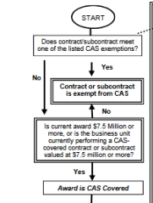
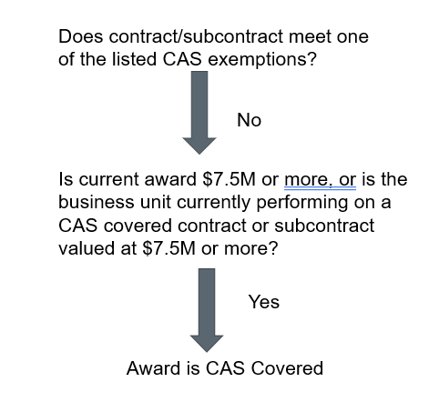
CAS Determination
Notes:
There are potentially 2 questions that need to be answered to determine if a contract award is CAS covered, they are:
Does the contract/subcontract meet one of the exemptions. If the answer is No, then we go to the 2nd questions, which is:
Is current award $7.5M or more, or is the business unit currently performing on a CAS covered contract or subcontract valued at $7.5M or more? If the answer is yes, the award is CAS covered.

Slide 11
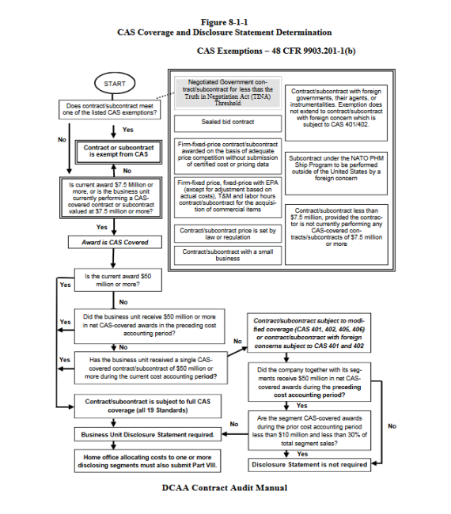
Full Or Modified Coverage
Notes:
There are potentially 2 questions that need to be answered to determine if a contract award is CAS covered, they are:
Does the contract/subcontract meet one of the exemptions. If the answer is No, then we go to the 2nd questions, which is:
Is current award $7.5M or more, or is the business unit currently performing on a CAS covered contract or subcontract valued at $7.5M or more? If the answer is yes, the award is CAS covered.

Slide 12
Full Or Modified Coverage – Applicable Standards
Full
All 19 Standards
Disclosure Statement Required
Modified
CAS covered contract award greater than $7.5M (trigger), but less than $50 for a single award or combined awards in the prior period

Slide 13
Full Or Modified Coverage
Full vs. Modified CAS Coverage
Full
Single CAS covered award of $50M or more
Business unit received $50M or more in net CAS covered prime and subcontract awards during prior period
Modified
Must comply with
CAS 401
CAS 402
CAS 405, and
CAS 406
May have to file Disclosure Statement

Slide 14
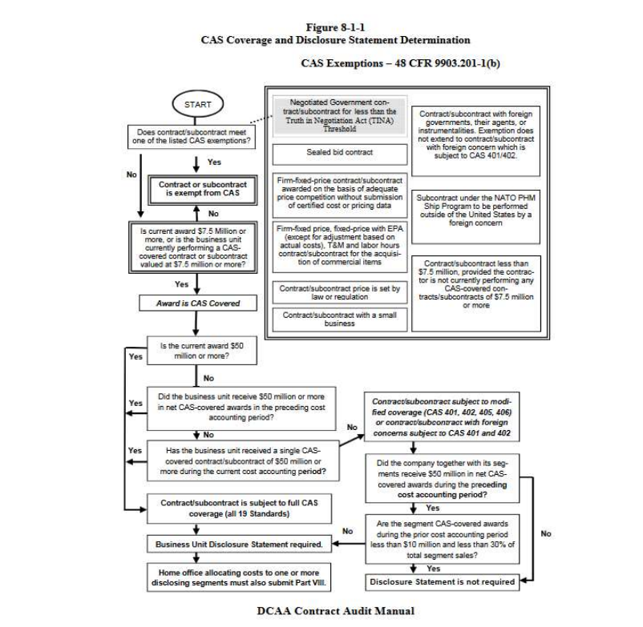

Slide 15
19 Cost accounting Standards
19 Standards Categorized into 4 Categories for Discussion
Consistency
Allocation
Compensation
Tangible Assets/Capital and Insurance

Slide 16
Cost Accounting Standards – Consistency
CAS 401 – Consistency in Estimating, Accumulating, and Reporting Costs
CAS 402 – Consistency in Allocating Cost Incurred for the Same Purpose
CAS 405 – Accounting For Unallowable Costs
CAS 406 – Cost Accounting Period
Note, these are the 4 standards that apply under modified CAS

Slide 17
Cost Accounting Standards – Allocation
CAS 403 – Allocation of Home Office Expenses to Segments
CAS 410 – Allocation of Business Unit G&A to Final Cost Objectives
CAS 418 – Allocation of Direct and Indirect Costs
CAS 420 – Accounting for IR&D/B&P Costs

Slide 18
Cost accounting Standards – Compensation
CAS 408 – Accounting for the Cost of Compensated Personal Absence
CAS 415 – Accounting for the Cost of Deferred Compensation
CAS 412 – Compensation and Measurement of Pension Costs
CAS 413 – Adjustment and Allocation of Pension Costs

Slide 19
Cost Accounting Standards – Tangible Assets, Capital Standards, and Insurance
CAS 404 – Capitalization of Tangible Capital Assets
CAS 407 – Use of Standard Costs for Direct Material and Direct Labor
CAS 409 – Depreciation of Tangible Capital Assets
CAS 411 – Account for Acquisition Costs of Material
CAS 414 – Cost of Money as an Element of the Cost of Facilities Capital
CAS 416 – Accounting for Insurance Costs
CAS 417 – Cost of Money as an Element of the Cost of Capital Assets Under Construction

Slide 20
Cost Accounting Standards – disclosure statement
What is it?
A written summary of a contractor’s cost accounting practices set at 48 CFR, 9903.202-9
Standard form submitted for segments and home office units
DS Form, CASB DS-1
Who must file?
Business Unit receiving an award of $50M or more
Business Unit receiving awards of $50M or more in the prior accounting period (FY)
Home Office allocating cost to Disclosing Segments
Issues
Deviations from disclosed practices potential non-compliance
Level in detail
Lesser details – greater flexibility, but more potential for disagreement/clarification
Greater details – less flexibility, but potentially less government disagreement/clarification

Slide 21
Cost Accounting Standards – Non-Compliances
FAR 52.230-3(a)(4) permits the government to adjust a contract price if CAS noncompliance results in “any aggregate increased costs paid by the government.

